Slide 1
Hosting Projects with Open Mainframe Project

Slide 2
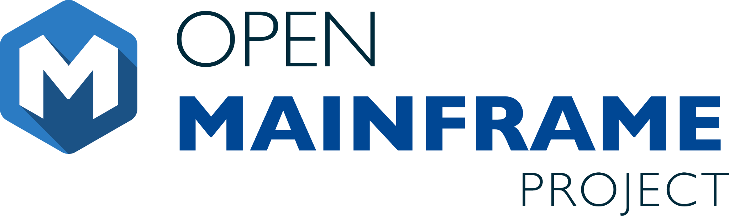




Vision
The mainframe is an active, integrated, and essential part of modern enterprise IT, consumable by mainstream developers and users, and driven by a vibrant open source community.
Mission
To achieve the vision of the Open Mainframe Project by…
Setting a high bar for application development on the mainframe
through documentation, API development, and a security-first approach.
Showcase the mainframe of today
to both the mainframe ecosystem as well as the broad enterprise IT community.
Enable the mainframe to be more consumable by developers
with a transparent experience in leveraging the value propositions of the mainframe.
Ensure the mainframe aligns well in the changing enterprise IT landscape
of cloud-native and DevOps.
Notes:
The mission of the Open Mainframe Project is to build that community and adoption of Open Source on the mainframe, which will ( read points above )
Image from https://www.openmainframeproject.org/about

Slide 3
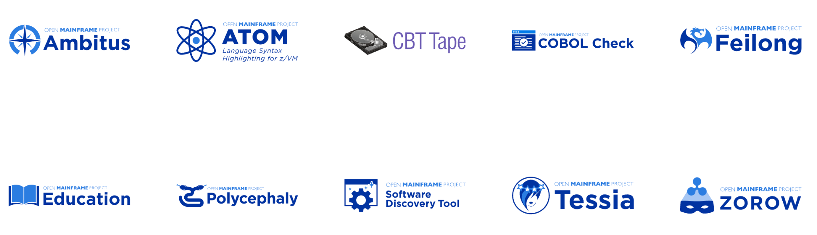
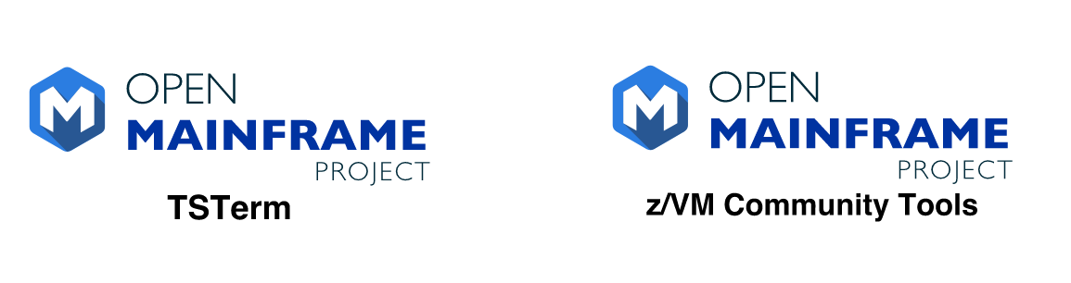
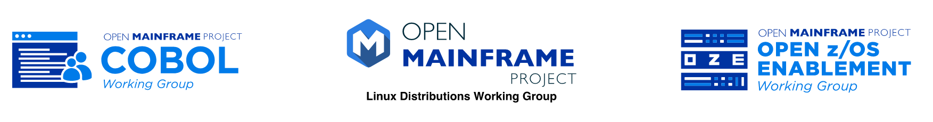
Open Mainframe Project enables this innovation
Active
Incubation
Sandbox
Working Groups
Learn about all Open Mainframe projects at https://www.openmainframeproject.org/projects
Notes:
Open Mainframe Project enables this innovation as a host of 18 projects and working groups that are part of closing the gap.
Source: https://landscape.openmainframeproject.org/pages/hosted-projects

Slide 4
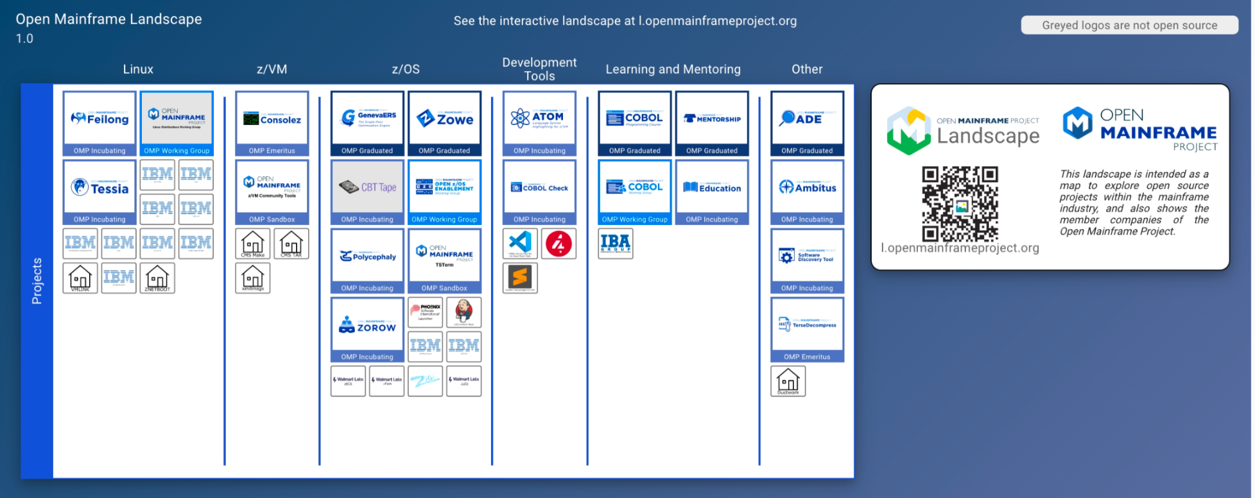
Landscape of open source projects only on mainframe
Source: https://landscape.openmainframeproject.org/fullscreen
Notes:
The ecosystem of open source on mainframe continues to grow, thanks to the work of the open source community on mainframe.
Source: https://landscape.openmainframeproject.org/fullscreen

Slide 5
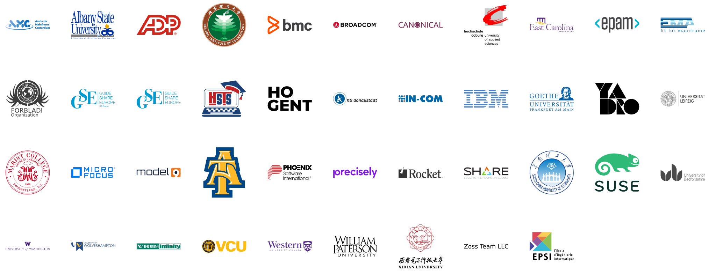
7 years since launch | 43 Supporting Organizations | 20 Hosted Projects and Working Groups | 70+ Mentees Sponsored | 1000+ Project Contributors | 61,000+ Project Contributions
Notes:
In over 5 years, the project has seen tremendous growth by tripling members since launch and growing from 1 project to 18, making huge impacts on the open source on mainframe ecosystem.
Source: https://landscape.openmainframeproject.org/pages/members-non-grouped

Slide 6
The Real Question is Which Projects Matter?
Value of of Individual Project
Number of Open Source Projects

Slide 7
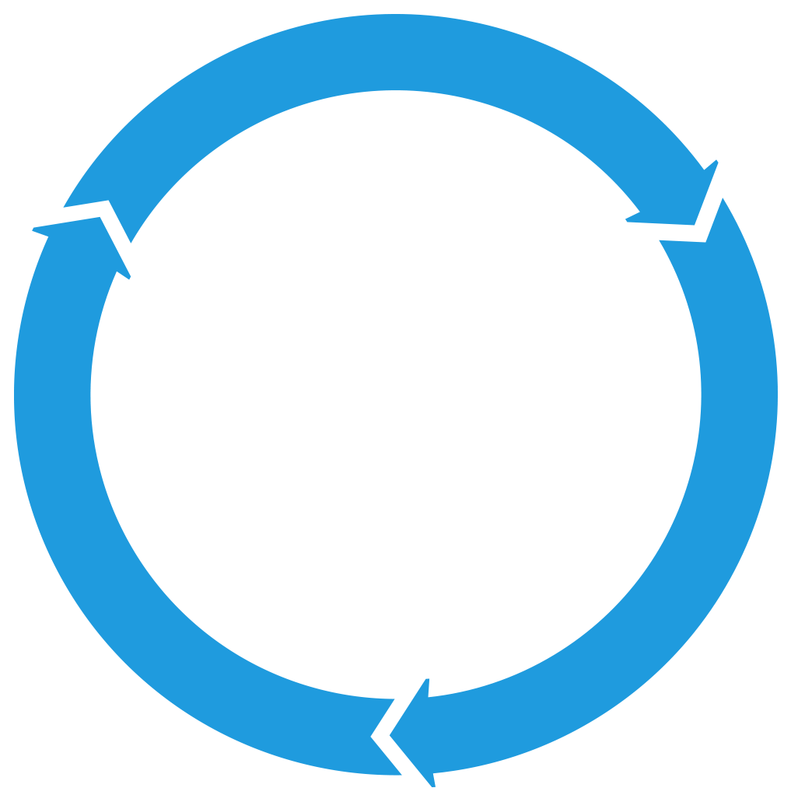
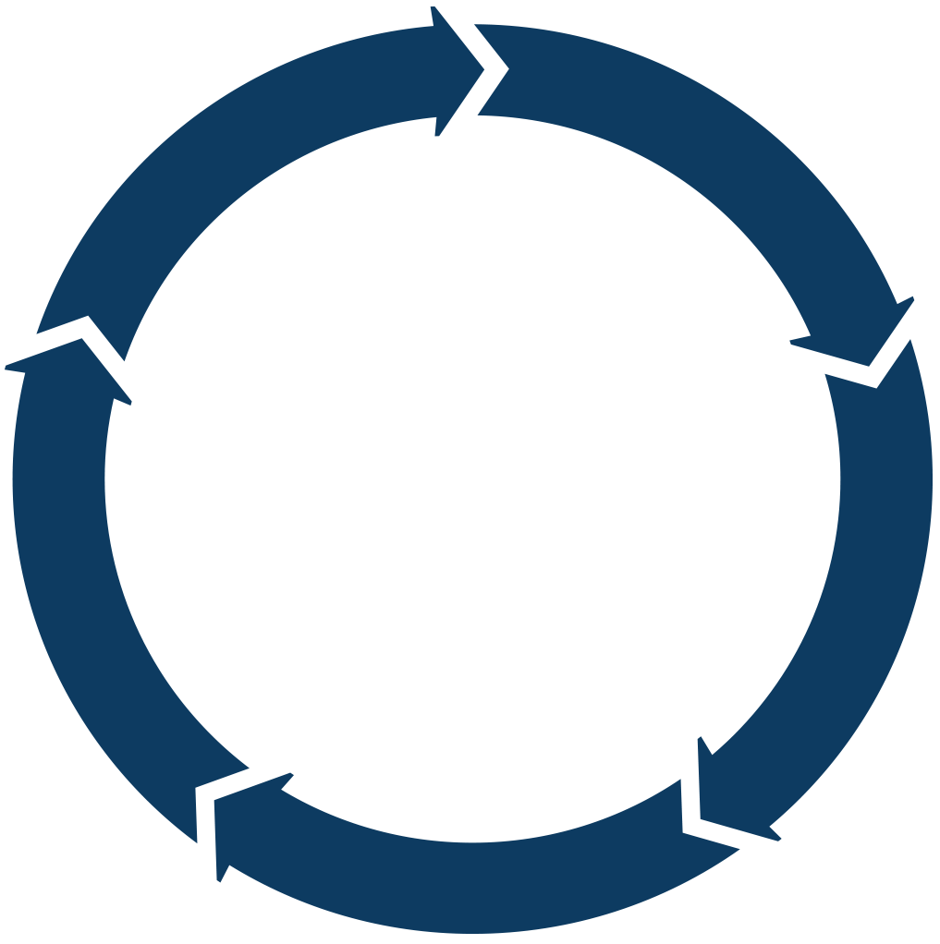
The Answer: Projects With Sustainable Ecosystems
PROJECTS
Sustainable projects have a developer community whose technology is used in commercial solutions that profit businesses, who in turn participate and reinvest back into the project and hire developers to work in the community.
DEVELOPER
COMMUNITY
TECHNOLOGY
PARTICIPATION
PRODUCTS
PROFITS
MARKETS
PRODUCTS

Slide 8
Open Source on Mainframe - Ecosystem Challenges
Glass ceiling for project investment and adoption
in the absence of a fair governance and safe haven for the project’s assets
1
Managing projects assets
As project grows, it is unclear who should own legal and administrative tasks that are essential to the health of the project
2
Developed for a specific product needs
The open source spinoff is a result of wanting to build an ecosystem and collaborate on building a platform
3
Governance challenges
No formal governance,
governance favors the creators of the project,
project backer dominating dev and governance
4
Fragmentation
Lack of integration
Lack of cross pollination across projects
5

Slide 9
Creating sustainable open source projects requires real work
Governance and Membership
Incorporation, Tax status, Bylaws, Member Agreements, Anti-trust, etc.
Ongoing business development and membership recruitment
Development Process
Technical Decision Making
Project Life Cycle
Release Process
Infrastructure
Custom infrastructure using open source best practices
Security and reliability
Ecosystem Development
Marketing
Events
Training
IP Management
Code Provenance and License compliance
Trademark management
Legal defense and Collaboration

Slide 10

Case Study: Zowe
Open Mainframe Project focuses on projects that are critical for industry
Major Problem
How OMP Innovated
Results - 2022
Modernize integration with z/OS based applications and services
Bridge the talent gap by enabling modern development stacks on z/OS
2018 Open Mainframe Project added Zowe from contributions from Broadcom, IBM, Rocket Software
2019 Zowe reached 1.0, launched Zowe Conformant to enable downstream ecosystem
2021 Zowe formed TSC to have technologists lead project direction; Zowe Support Conformance program launched
2022 Zowe 2.0 launched
30000+ Commits, 250+ committers all time
Zowe gaining significant mindshare in DevOps community
50+ Zowe Conformant offerings from Broadcom, IBM, MicroFocus, Phoenix Software International, Rocket Software, BMC
New project contributions from BMC, IBA Group, Vicom Infinity, and others, has grown codebase
Value of of Individual Project
Number of Open Source Projects – Millions on Github

Slide 11
Why host your project at Open Mainframe Project?

Slide 12
Question: Value of a Foundation?
There have been times when projects have asked what the value of an open source foundation can offer them?
A basic premise behind the LF, and open source in general, is that most interactions are positive-sum. There is no fixed amount of investment, mindshare, or development contributions that is allocated to specific projects. Just as open source development is based on the idea that, collectively, we are smarter than any one of us, open source foundations work to make the entire community better off. Equally important, a neutral home for a project and community fosters this type of positive-sum thinking and drives growth and diversity that we believe are core elements of a successful open source project.

Slide 13
It’s more than putting a project on GitHub
Organizations and projects come to the Open Mainframe Project to…
Have a vendor-neutral home for the project and assets.
Bring in contributors from different organizations ( including your competitors )
Drive broad industry awareness with press and analysts.
Build a downstream ecosystem for open and commercial solutions.
Have world-class tools for measuring project insights and success.
Leverage the collective experience and expertise of the Linux Foundation.
How does the Open Mainframe Project enable this?

Slide 14

Vendor-neutrality provides a sustainable home
Groundbreaking and game-changing projects are a collective effort across organizations. Hosting at the Open Mainframe Project ensures a project has a reputable legal home and governance to attract contributors and adoption.
All projects are set up as 501c6 Series LLC legal entities, giving the project a non-profit status and giving them the autonomy to set their own policies and processes with expert guidance.
Infrastructure such as mailing lists, websites, and domain names are owned by the project to ensure neutral management.
Open Mainframe Project TAC project lifecycle gives the project guidance on how to establish a sustainable project.

Slide 15

Bring in a broader contributor base
Shared R&D with a broad ecosystem means bringing more contributors and maintainers into your project - including your competitors.
Our staff works with the project to establish an open, neutral governance that makes roles clear and paths to leadership available.
All projects have a Code of Conduct to ensure collaboration is done in safe and welcoming environment for all.
Outreach done through the Open Mainframe Project is done from a neutral perspective, which separates out product promotion and vendor favoritism and promotes the work of the community.

Slide 16


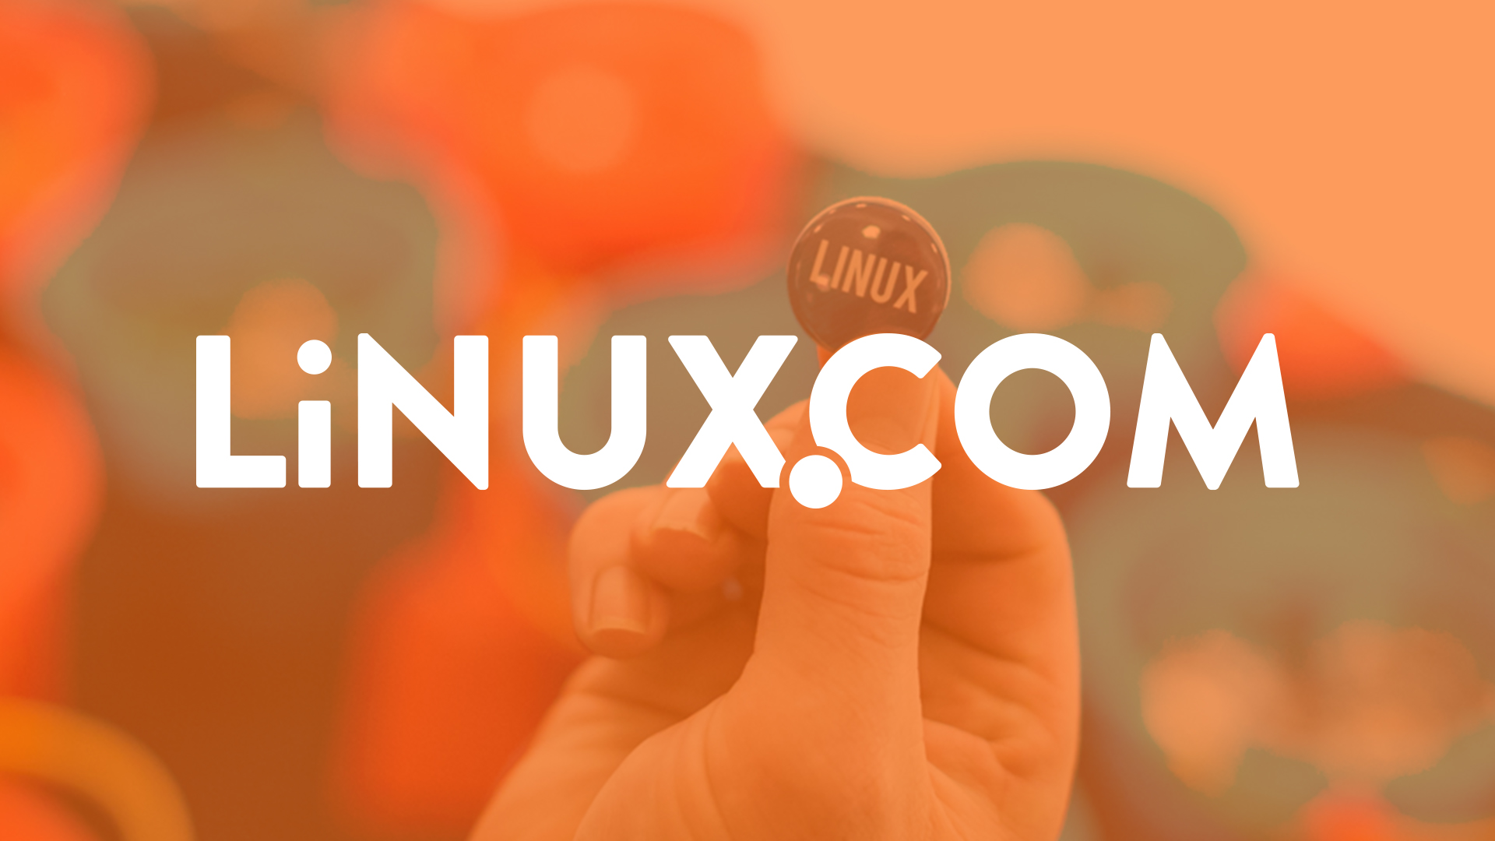





Drive broad industry awareness with press and analysts
Through our large audience, extensive media outreach, and with key partnership with publications such as Linux.com, TFiR, TechChannel, and MediaOps, your project will get broad exposure in mainframe, tech, and open source.
Your project will be featured on both the Open Mainframe Project website and Linux Foundation website.
Always available guest blog post(s) on the Open Mainframe Project blog on project updates.
Provide a guest for the “I Am A Mainframer” podcast, hosted by Steven Dickens and Open Mainframe Project
Post one technical article about an open source project you care about to Linux.com, which has over 1 million unique visitors per month.
Support of your announcements with social outreach and quotes from Linux Foundation and/or Open Mainframe Project leadership as appropriate.
Access to opportunities for contributed articles, videos, podcasts, and events
5000+
followers
3000+
followers
1100+ global media articles in 2021 from 5 press announcements

Slide 17


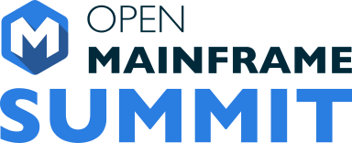
Build a downstream ecosystem for open and commercial solutions
Sustainable projects are those the industry adopts and drive economic value with. Doing this at the Open Mainframe Project takes advantage of the expertise in building these programs.
Conformance programs with community requirements that are managed by the Open Mainframe Projects
Training and certification programs through LF Training
Badging using Credly to recognize individuals
Events for the community to connect and collaborate.

Slide 18
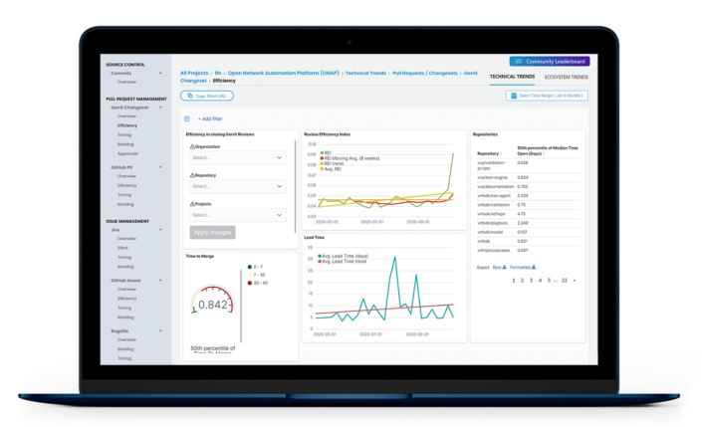


World class tools with LFX
LFX Insights is an analytics tool that is provided to all open source projects hosted by the Linux Foundation. Its capabilities include:
Getting the visibility you need to remove bottlenecks at any stage of your project’s code pipeline. Drill down into performance metrics across every step in the development lifecycle to identify where you should be focusing your resources.
Ensuring the health and viability of the open source projects you care about. Leverage data to help validate projects for investment, and track the activity and growth of projects your organization is already involved in.
Showcasing your organization’s leadership and subject matter expertise in the open source community. Leverage affiliations to measure the impact of your employees’ contributions and capture the full picture of your team’s impact
LFX Security is a tool for managing security for your project. It’s capabilities include:
Monitoring of your entire project for potential vulnerabilities with an aggregated project-level view of your entire software sandwich across source control systems and repositories, with the ability to remediate the found issues.
Identifying non-inclusive language and code secrets in your project to prevent embarrassing situations.

Slide 19
Leverage the collective experience and expertise of the Linux Foundation
Open Mainframe Project staff collective have decades of experience in driving open source projects and ecosystems in a variety of vertical and horizontal industries, bringing the best practices to your project
Press relations and analyst relations teams to increase awareness of and excitement about your project, and receive regular reports on press mentions and comparisons to similar projects.
Open Mainframe Project is able to leverage the expertise of its parent organization, The Linux Foundation, which hosts other successful projects including the Linux kernel, Let’s Encrypt, and Node.js. For example, Open Mainframe Project has worked on cross project collaboration between Kubernetes, HyperLedger, and Cloud Foundry for improving mainframe support of those technologies.
You will have access to full-time Open Mainframe Project staff who are eager to assist your project in myriad ways and help make it successful

Slide 20
Bringing your project here

Slide 21
Anna Karenina Principle of Open Source
https://en.wikipedia.org/wiki/Anna_Karenina_principle
All happy open source projects are alike; each unhappy open source project is unhappy in its own way…
The “LF Way” is that there is no one way...
The LF assumes that each open source project is unhappy/different in its own way and that leads to building a unique governance and solution to sustain their communities...

Slide 22
Basic requirements for hosting a project at Open Mainframe Project
The project must:
use an approved OSI open source license, preferably inline with the Open Mainframe Project IP Policy;
be supported by a TAC member;
allow neutral ownership of project assets such as a trademark, domain or GitHub account (the community can define rules and manage them);
technical do-ocracy and separation of business governance from technical governance (we're flexible on the model) clearly documented in a charter;
allow anyone to participate in the technical community, whether or not a financial member or supporter of the project
Often projects are new open source project, but that isn’t a requirement - existing projects are welcome!

Slide 23
You can bring a project in any stage
SANDBOX
INCUBATION
ACTIVE
Establish code base
Form Governance
Build mission and roadmap
Setup project infrastructure
INVESTMENT
Start training and conformance programs
Establish long term support
Diversify maintainers
Grow diverse contributor base
Refine processes and governance
Build end-user community
TIME
Read more about the project lifecycle at https://tac.openmainframeproject.org/process/project_stages.html

Slide 24
Project Preparation Checklist
Prepare draft mission and scope statement
Identify internal teams within mission and scope
Identify developers internally
Analyze code for identification of licenses, license quality and project dependencies
Assess potential universe of project participants
Identify ecosystem constituents and concerns of each
Identify any trademarks leveraged by the project (these will be owned by the LF neutrally)
Outline infrastructure, marketing any other requirements needed for the project
Complete the project proposal and submit to the TAC for consideration
The Open Mainframe Project staff is happy to engage and advise during this process - let us know how we can help!

Slide 25
Project Trademarks
Our project communities control the name of the project, not any one member or company contributor
In order to provide for neutral ownership of project assets, we require that The Linux Foundation entities own the trademarks leveraged by the project.
In the event that a trademark is already in use by the sponsoring organization, we recommend that the project create a new name to operate under or the owner assign the interest in the mark to The Linux Foundation.
See http://fossmarks.org for an education on trademarks in open source

Slide 26


Learn more about the Open Mainframe Project
Find out more at openmainframeproject.org
See the breadth of open source on the mainframe at l.openmainframeproject.org
Discover and participate in any of our 20 hosted projects and working groups at openmainframeproject.org/projects
Take part in our upcoming events and webinars at openmainframeproject.org/events
Notes:
You can get involved and learn more by...

Slide 27
Thank you!

